Slide 1
Lecture 3 Investigating Relationships (part 2)
Faculty of Computer Science
Data Analysis
Moscow 2025
Lecturer: Alisa Melikyan, amelikyan@hse.ru, PhD,
Associate Professor of the School of Software Engineering

Slide 2
Student’s t-test
Data Analysis
Lecture 3
Investigating Relationships
A t-test is a statistical test that checks if two means are reliably different from each other.
The values of the means may show a difference, but we can’t be sure if that is a reliable difference.
Descriptive statistics only describes the data but can’t be generalized beyond that. Inferential statistics, like t-test, allows to make inferences about the population beyond our data, generalize the findings to a whole population beyond the sample, that is tested.

Slide 3
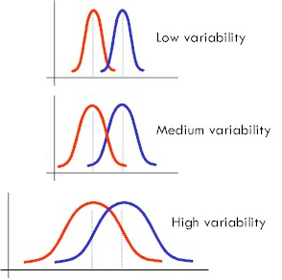
Same means with different variabilities
Data Analysis
Lecture 3
Investigating Relationships

Slide 4
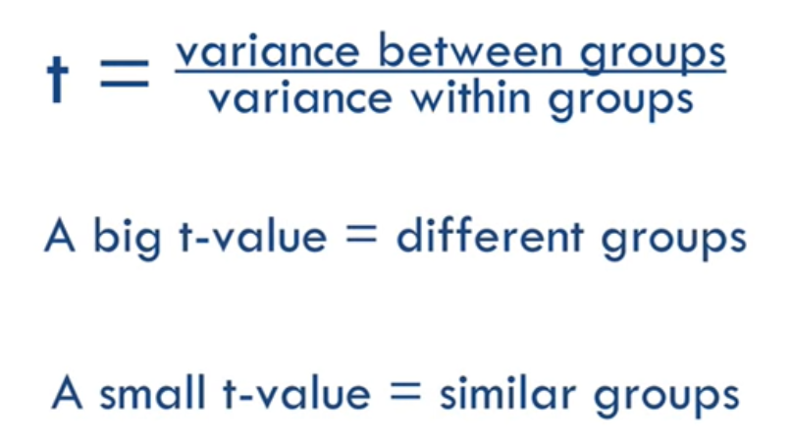
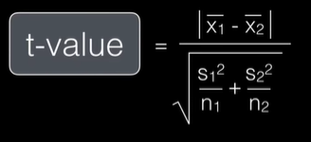
t-test
Data Analysis
Lecture 3
Investigating Relationships

Slide 5
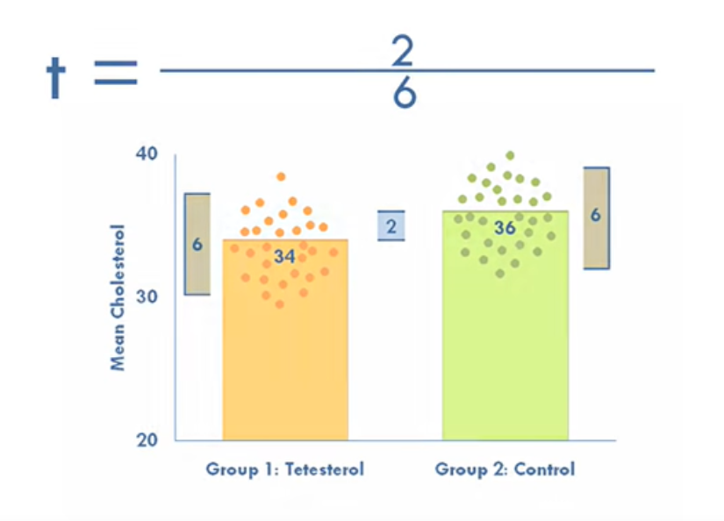
t-test
Data Analysis
Lecture 3
Investigating Relationships
t = 2/6 → the value is not big enough to be reliable → we can’t say that there is a statistically significant difference between the means.

Slide 6
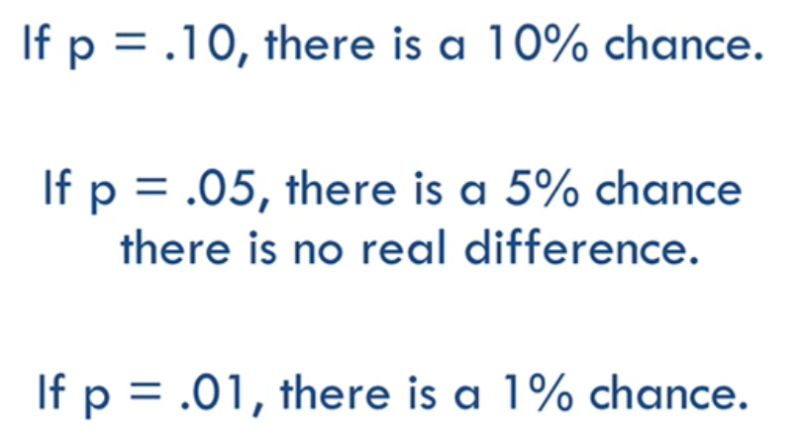
t-test
Data Analysis
Lecture 3
Investigating Relationships
Each t-value has a corresponding p-value, which tells us the likelihood that there is a real difference. P-value is the probability that the pattern produced by our data could be produced by random data. It tells us whether the difference between our groups is real or if it’s just a fluke. The p-value for each t-value depends on the sample size. Bigger samples make it easier to detect differences.

Slide 7
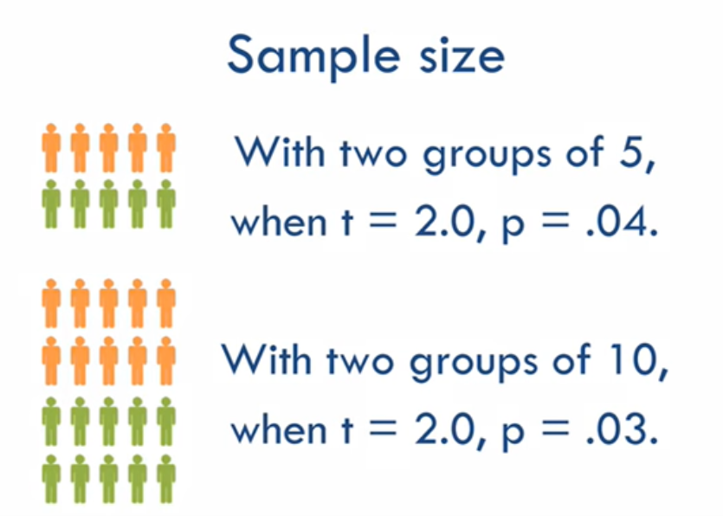
t-test
Data Analysis
Lecture 3
Investigating Relationships

Slide 8
Types of t-test
Data Analysis
Lecture 3
Investigating Relationships
Independent-samples t-test tests the means of two different groups. Is also called between-samples or unpaired-samples t-test.
Paired-samples t-test tests the mean of one group twice. For example, students’ knowledge in data analysis before and after taking the course. It’s also called within-subjects, repeated-measures or dependent-samples t-test.
One-sample t-test compares the mean in one group with a hypothetical value or known population mean.

Slide 9
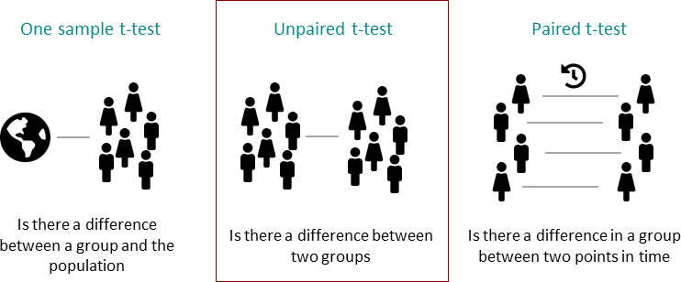
Types of t-test
Data Analysis
Lecture 3
Investigating Relationships

Slide 10
Hypotheses
Data Analysis
Lecture 3
Investigating Relationships
Independent-samples t-test
H1: the mean salaries of men and women are different
Paired-samples t-test
H1: the mean salaries of employees of this organization before and after restructuring are different
One-sample t-test
H1: the mean salary of employees of this organization is different from the average salary in the region

Slide 11
Limitations of t-test
Data Analysis
Lecture 3
Investigating Relationships
The results of inferential statistics can only be applied to populations that resemble the sample that was tested.
The data should be approximately interval-level or higher.
The sample as well as the population should be roughly normal in distribution.
Each group should have about the same number of data points, but not less than 20-30.
Scores should not be influenced by each other.

Slide 12
Overcoming several limitations
Data Analysis
Lecture 3
Investigating Relationships
Non-parametric tests do the same job as t-tests but can be applied to non-normal distributions and ordered-level data. But these tests are less powerful.

Slide 13
Independent Samples t-test
Data Analysis
Lecture 3
Investigating Relationships
The World Bank assigns the world’s economies to four income groups – low, lower-middle, upper-middle, and high-income countries.
H1: the mean values of the percent of travel services our of service exports for high income countries and other countries are different.
Dependent variable: Travel services (% of service exports)
Grouping variable: 1 – high income countries, 0 – other countries.
p-value is 0.0002 < 0.05 → the probability of making an error while rejecting H₀ and accepting H₁ is very low, we will accept H₁ and conclude that there is a statistically significant difference in mean values of the dependent variable in the two groups.

Slide 14
Paired Samples t-test
Data Analysis
Lecture 3
Investigating Relationships
We have the values of the variable Travel services (% of commercial service exports) for the same countries for two years – 2023 and 2024.
H1: the mean values of the percent of travel services our of commercial service exports for countries in 2023 and in 2023 are different.
H0: mean values are not different
p-value is 0.43 > 0.05 → the probability of making an error while rejecting H₀ and accepting H₁ is too high, we will reject H₁ and conclude that there is no statistically significant difference in mean values of the variable for two time periods.

Slide 15
ANOVA
Data Analysis
Lecture 3
Investigating Relationships
ANalysis Of Variance (ANOVA) tests whether more then two population means are equal or not, and therefore generalizes the t-test beyond two means.
H0: all means are equal m₀ = m₁ = m₂ = … = m_{n}
H1: not all means are equal (at least one pair of means is different)

Slide 16
ANOVA
Data Analysis
Lecture 3
Investigating Relationships
Dependent variable: Travel services (% of service exports)
Grouping variable: 1 – high income countries, 2 – middle income countries, 3 – low income countries
H1: the mean values of the percent of travel services our of service exports for groups of countries based on income are different
H0: mean values are not different
p-value is 0.0001 < 0.05 → the probability of making an error while rejecting H₀ and accepting H₁ is very low, we will accept H₁ and conclude that there is a statistically significant difference in mean values of the dependent variable for the three groups.
Based on this test we can’t conclude in which groups the means are different and in which they are not.

Slide 17
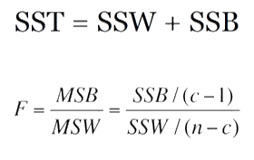
ANOVA
Data Analysis
Lecture 3
Investigating Relationships
The significance of ANOVA is tested based on the value of F statistic.
Number of groups
Number of cases

Slide 18
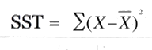
ANOVA: SST
Data Analysis
Lecture 3
Investigating Relationships
Group 1: 1, 3, 5 Sample mean:
Group 2: 5, 7, 9 (1+3+5+5+7+9+4+5+6)/9 = 5
Group 3: 4, 5, 6
Total sum of squares (SST): 42
(1-5)² + (3-5)² + (5-5)² + (5-5)² + (7-5)² + (9-5)² + (4-5)² + (5-5)²+ (6-5)² = 16 + 4 + 0 + 0 + 4 + 16 + 1 + 0 + 1 = 42

Slide 19
ANOVA: SSW
Data Analysis
Lecture 3
Investigating Relationships
Group 1: 1, 3, 5 mean 1 = (1+3+5)/3 = 3
Group 2: 5, 7, 9 mean 2 = (5+7+9)/3 = 7
Group 3: 4, 5, 6 mean 3 = (4+5+6)/3 = 5
Sum of squares within groups (SSW):
SSW1 = (1-3)² + (3-3)² + (5-3)² = 4 + 0 + 4 = 8
SSW2 = (5-7)² + (7-7)² + (9-7)² = 4 + 0 + 4 = 8
SSW3 = (4-5)² + (5-5)² + (6-5)² = 1 + 0 + 1 = 2
SSW = SSW1+SSW2+SSW3 = 8 + 8 + 2 = 18

Slide 20
ANOVA: SSB
Data Analysis
Lecture 3
Investigating Relationships
Group 1: 1, 3, 5 Sample mean:
Group 2: 5, 7, 9 (1+3+5+5+7+9+4+5+6)/9 = 5
Group 3: 4, 5, 6
Mean 1 = (1+3+5)/3 = 3
Mean 2 = (5+7+9)/3 = 7
Mean 3 = (4+5+6)/3 = 5
SSB1 = 3*(3-5)² = 12
SSB2 = 3*(7-5)² = 12
SSB3 = 3*(5-5)² = 0
SSB = SSB1+SSB2+SSB3 = 12 + 12 + 0 = 24

Slide 21
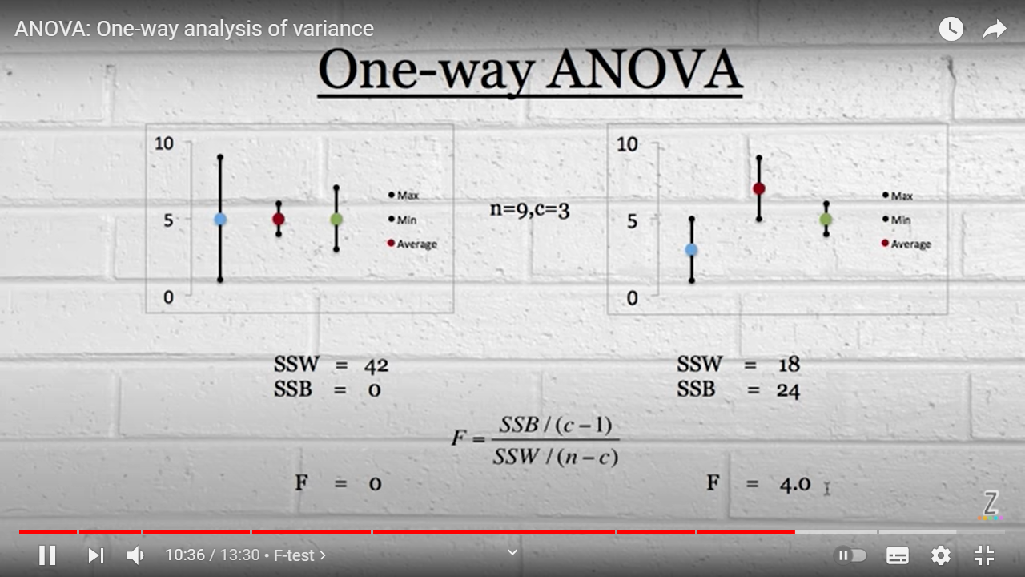
ANOVA
Data Analysis
Lecture 3
Investigating Relationships

Slide 22
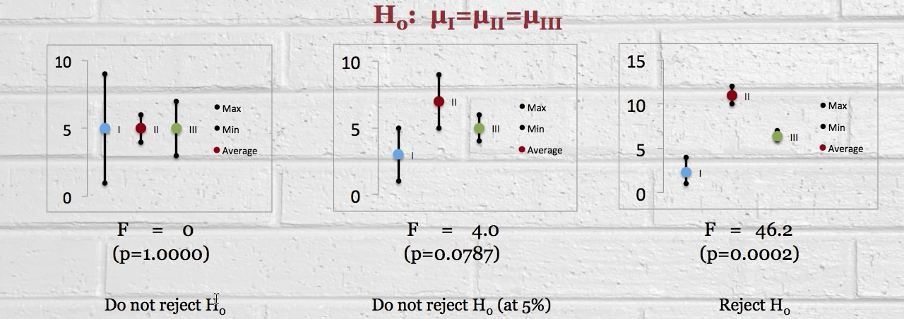
ANOVA
Data Analysis
Lecture 3
Investigating Relationships
Source: https://www.youtube.com/watch?v=9cnSWads6oo

Slide 23
Post-hoc test
Data Analysis
Lecture 3
Investigating Relationships
If ANOVA confirms that the means are not equal, we can do pairwise post-hoc testing to determine whether there is a difference between the means of all possible pairs (all pairwise comparisons).

Slide 24
Mann-Whitney U Test
Data Analysis
Lecture 3
Investigating Relationships
Is a non-parametric test, analogue of Independent-samples t-test. Can be performed for ordinal or non-normally distributed interval or ratio scale data.
H₁: The two populations are not equal

Slide 25
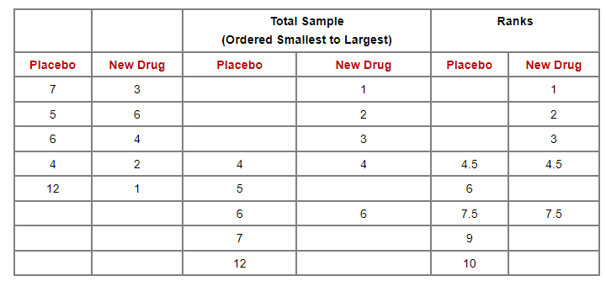
Mann-Whitney U Test
Data Analysis
Lecture 3
Investigating Relationships
https://sphweb.bumc.bu.edu/otlt/mph-modules/bs/bs704_nonparametric/bs704_nonparametric4.html

Slide 26
Wilcoxon signed-rank test
Data Analysis
Lecture 3
Investigating Relationships
Is a non-parametric test, analogue of Paired-samples t-test.
H₁: ranks of the group before and after treatment are not equal

Slide 27
Wilcoxon signed-rank test
Data Analysis
Lecture 3
Investigating Relationships
https://sphweb.bumc.bu.edu/otlt/mph-modules/bs/bs704_nonparametric/BS704_Nonparametric6.html#headingtaglink_1
Calculator: https://www.socscistatistics.com/tests/signedranks/default2.aspx
Patient | Before Treatment | After 1 Week of Treatment | Difference (Before-After)
1 | 85 | 75 | 10
2 | 70 | 50 | 20
3 | 40 | 50 | -10
4 | 65 | 40 | 25
5 | 80 | 20 | 60
6 | 75 | 65 | 10
7 | 55 | 40 | 15
8 | 20 | 25 | -5
Ordered Absolute Values of Differences | Ranks | Signed Ranks
-5 | 1 | -1
10 | 3 | 3
-10 | 3 | -3
10 | 3 | 3
15 | 5 | 5
20 | 6 | 6
25 | 7 | 7
60 | 8 | 8
W+ = 32 and W- = 4. The sums of positive and negative ranks are calculated and the smallest sum is selected. As a result, W=4.

Slide 28
Kruskal-Wallis test
Data Analysis
Lecture 3
Investigating Relationships
Is a non-parametric test, analogue of ANOVA.
Null hypothesis: the samples (groups) are from identical populations.
Alternative hypothesis: at least one of the samples (groups) comes from a different population than the others.

Slide 29
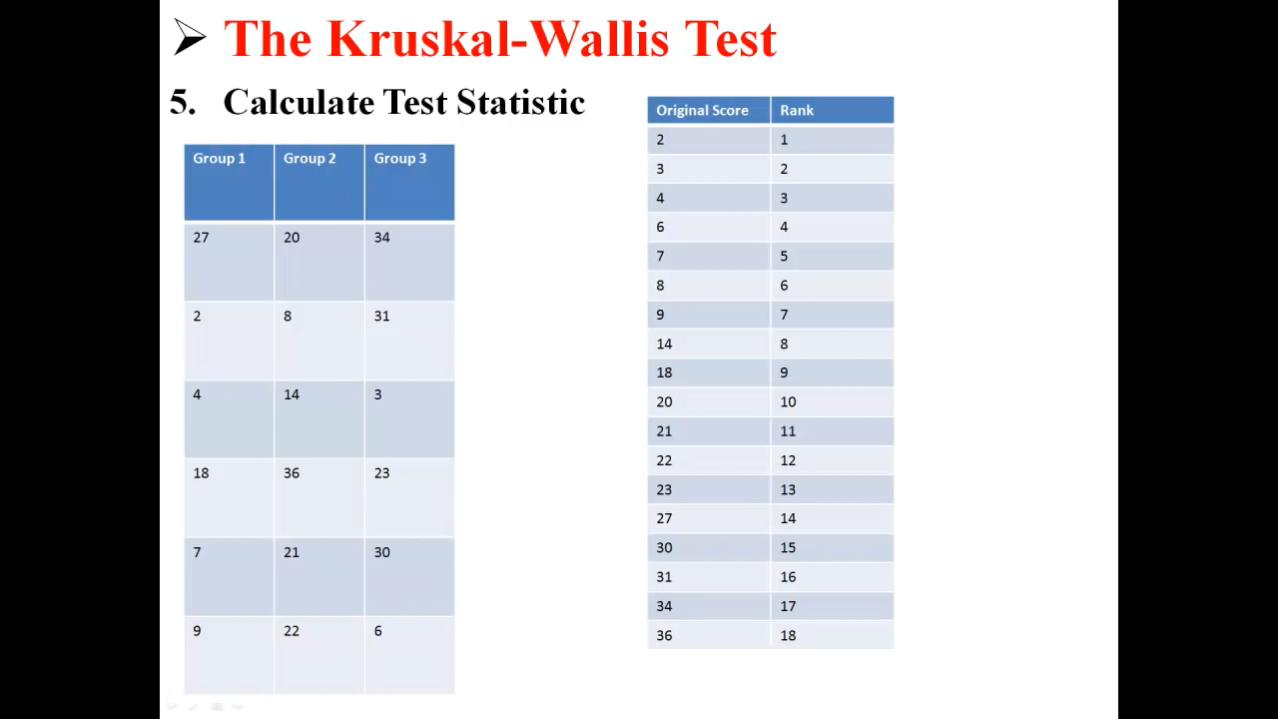
Kruskal-Wallis test
Data Analysis
Lecture 3
Investigating Relationships
First, we rank all the values regardless of the group to which they belong.

Slide 30
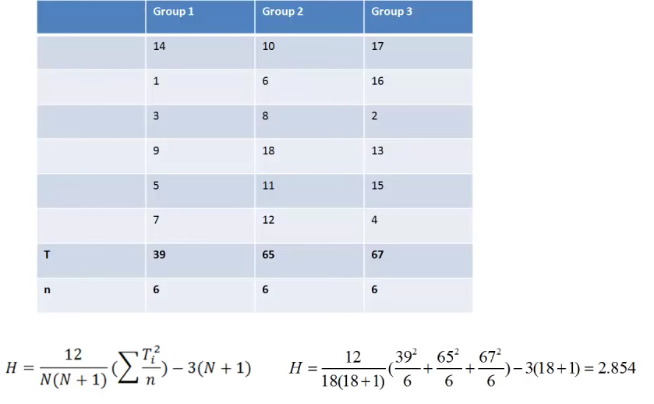
Kruskal-Wallis test
Data Analysis
Lecture 3
Investigating Relationships
https://sphweb.bumc.bu.edu/otlt/mph-modules/bs/bs704_nonparametric/BS704_Nonparametric7.html#headingtaglink_3
Then we replace values with ranks and in each group the sum of the ranks (T) is calculated
Source: https://www.youtube.com/watch?v=BkyGuNuaZYw

Slide 31
Comparing tests
Data Analysis
Lecture 3
Investigating Relationships
Type of samples | Parametric tests | Non-parametric tests
2 independent samples | t-test for two independent samples | Mann-Whitney U test
2 related samples | t-test for two paired samples | Wilcoxon signed-rank test
> 2 independent samples | ANalysis Of VAriance (ANOVA) | Kruskal-Wallis test

Slide 32
A/B testing
Data Analysis
Lecture 3
Investigating Relationships
Compares two versions of an app or webpage to identify the better performer. It compares options to learn what customers prefer. You can test website/app layouts, email subject lines, product designs, colors, etc. It’s a randomized experimentation process where in two or more versions of a variable (web page, page element, etc.) are shown to different segments of website visitors at the same time to define which version leaves the maximum impact and drives business metrics.
In A/B testing, A refers to ‘control’ or the original testing variable. Whereas B refers to ‘variation’ or a new version of the original testing variable. The version that moves business metric(s) in the positive direction is known as the ‘winner.’

Slide 33
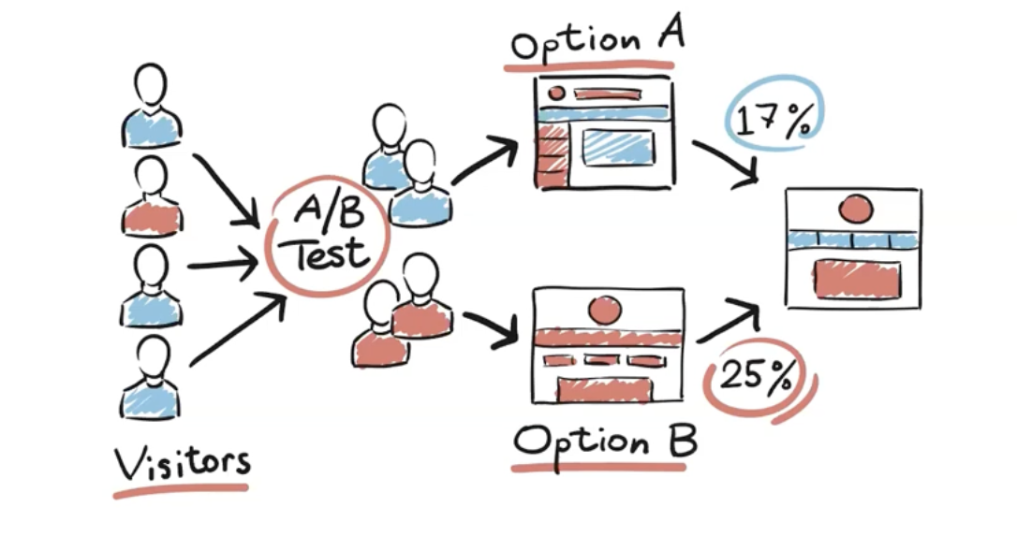
A/B testing
Data Analysis
Lecture 3
Investigating Relationships

Slide 34
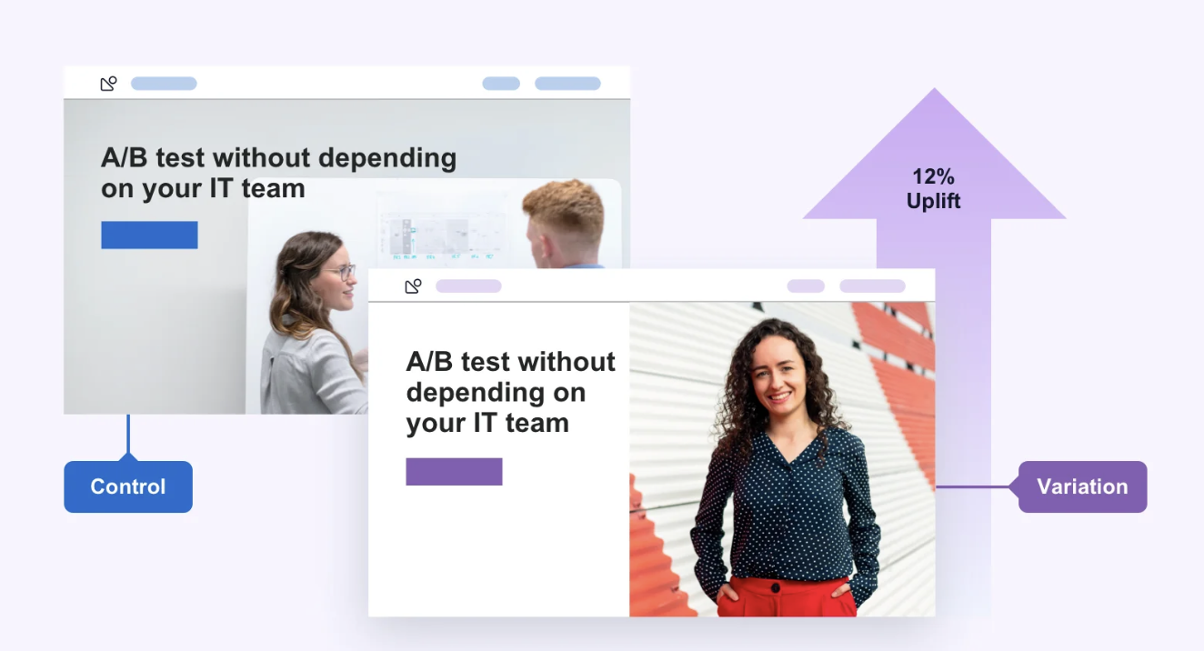
A/B testing
Data Analysis
Lecture 3
Investigating Relationships

Slide 35
Conversion rate
Data Analysis
Lecture 3
Investigating Relationships
Conversion rate records the percentage of users who have completed a desired action. Conversion rates are calculated by taking the total number of users who ‘convert’ (for example, by clicking on an advertisement), dividing it by the overall size of the audience and converting that figure into a percentage.
Conversion rates are an effective way of comparing and contrasting the performance of multiple advertising channels. Conversion rates are particularly important when running mobile user acquisition because they can measure the success of each campaign. A good conversion rate means a strong return on investment.

Slide 36
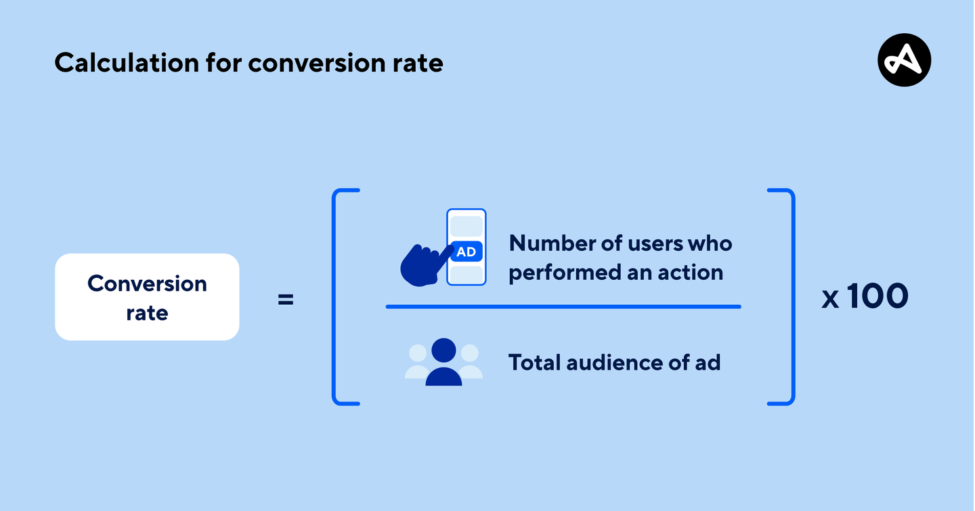
Conversion rate
Data Analysis
Lecture 3
Investigating Relationships
For example, an advertiser runs a campaign with an audience of 20,000 people. Out of that group, 800 people clicked on the ad (ie. converted). To calculate this example, divide 800 by 20,000 to get 0.04, or a 4% conversion rate.

Slide 37
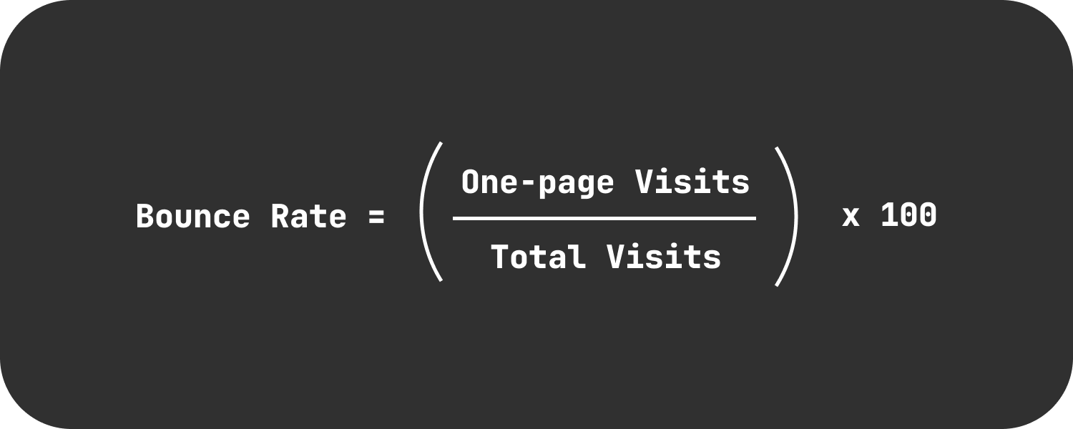
Bounch rate
Data Analysis
Lecture 3
Investigating Relationships
In contrast to conversion rate, bounce rate is the percentage of visitors who enter a landing page but leave without taking additional actions —they bounce right out of there. These exits are known as single-page sessions.

Slide 38
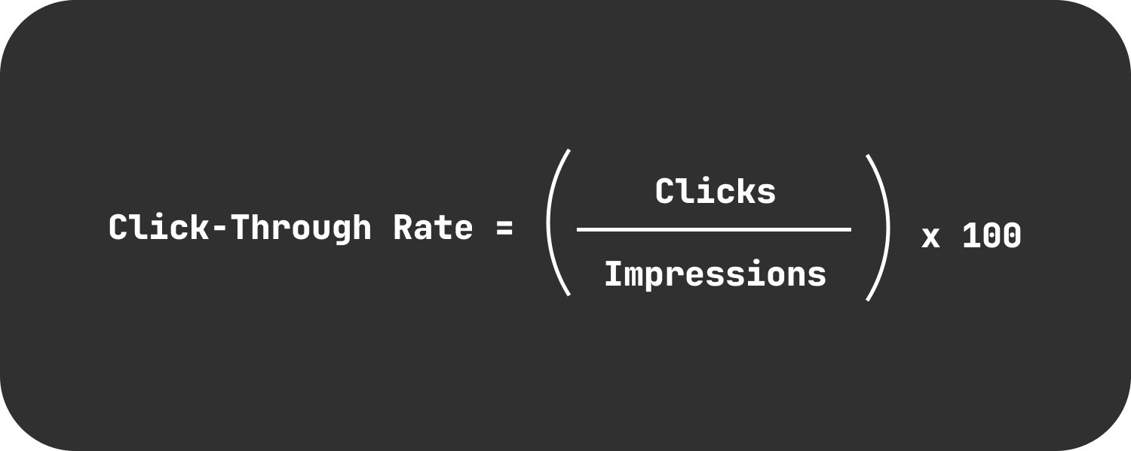
Click-through rate
Data Analysis
Lecture 3
Investigating Relationships
Measures the percentage of clicks on a specific link, as compared to the number of times the link was shown (AKA the number of impressions).

Slide 39
A/A testing
Data Analysis
Lecture 3
Investigating Relationships
A/A tests enable to test two identical versions of an element. The traffic to the website is divided into two, with each group exposed to the same variation. A/A testing can help to define whether the conversion rates in each group are similar and confirm that the solution is working correctly. It is also a good way to identify bugs and outliers that impact results thereby raising the level of trust in the experiments.

Slide 40
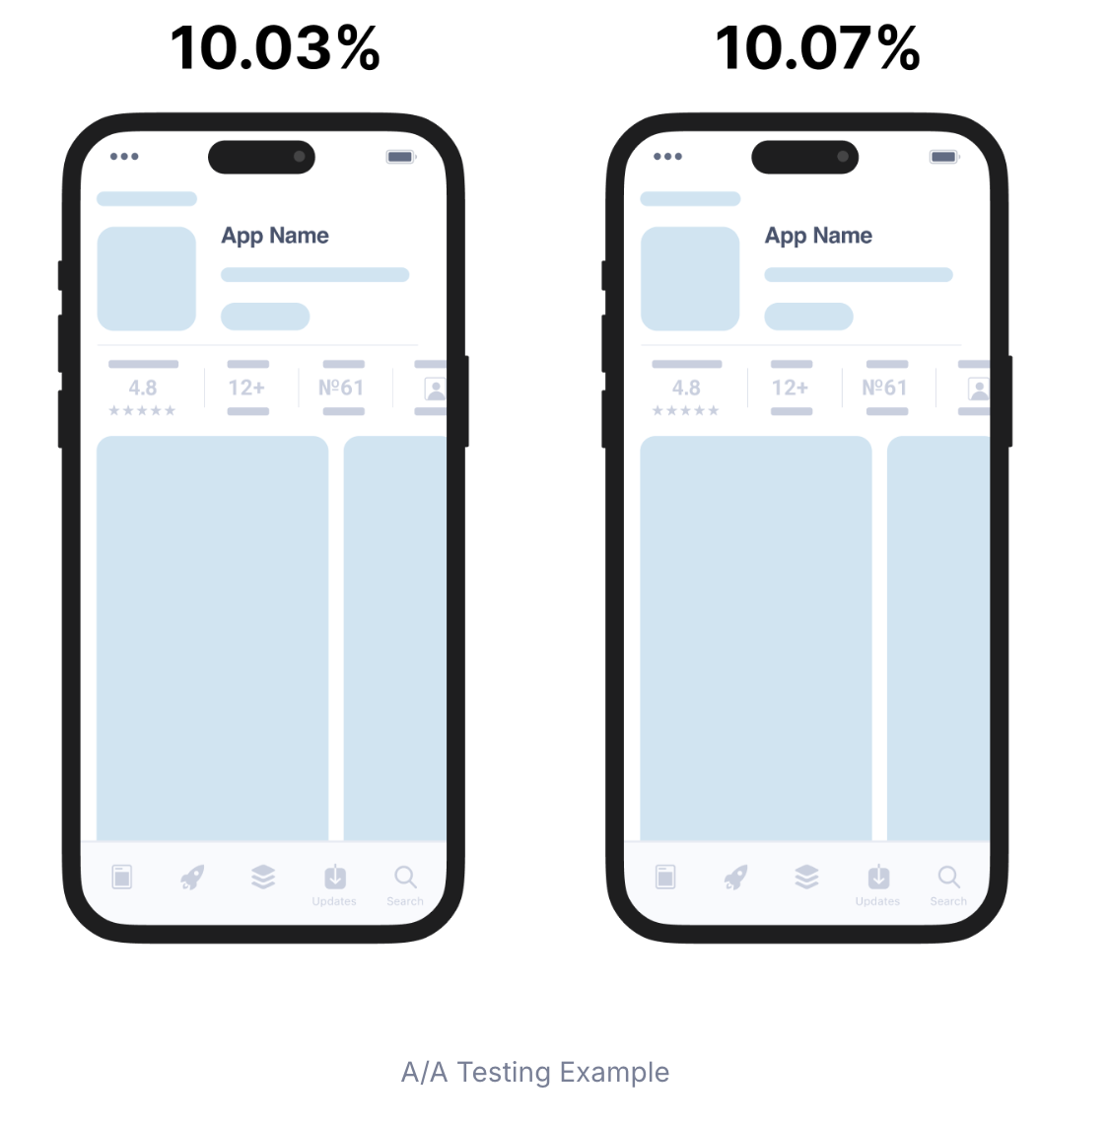
A/A testing
Data Analysis
Lecture 3
Investigating Relationships

Slide 41
A/B testing algorithm
Data Analysis
Lecture 3
Investigating Relationships
1. Understanding business problem & data
2. Detect and resolve problems in the data (Missing Value, Outliers, Unexpected Value)
3. Look at summary stats and plots
4. Apply hypothesis testing and check assumptions
Check Normality & Homogeneity
Apply tests (Shapiro, Levene Test, T-Test, Mann Whitney U Test, etc.)
5. Evaluate the results
6. Make inferences
7. Recommend business decision to your customer/director/CEO etc.

Slide 42
Possible metrics
Data Analysis
Lecture 3
Investigating Relationships
1. Revenue;
2. Conversion rate, bounch rate, click-through rate;
3. Profit margins (percentage of each dollar of revenue that the business keeps as profit after covering all costs);
4.Customer lifetime value (prediction of the total revenue a customer will generate throughout their relationship with the business);
5. User retention rate (percentage of users who keep engaging with the product, service, or content over a given period);
6. Customer satisfaction score;
7. Cart abandonment rate (percentage of shoppers who add items to their online shopping cart but leave without completing the purchase);
8. Click-through rate (how often people click on the links or ads after seeing them;
9. Average session duration;
10. Scroll depth.

Slide 43
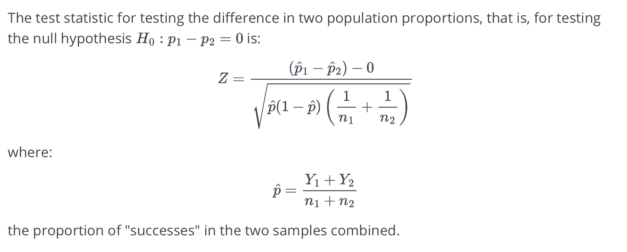
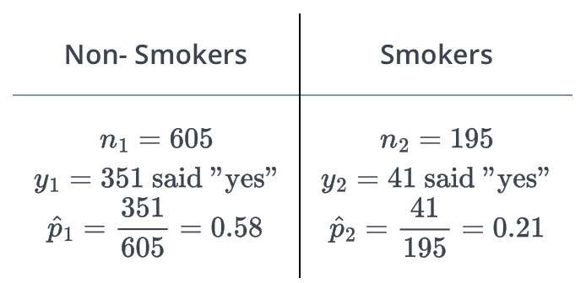
Using proportions test
Data Analysis
Lecture 3
Investigating Relationships
To define if the conversion rate for page A is significantly higher than page B, we do a difference of proportions test.

Slide 44
A/B testing examples from kaggle.com
Data Analysis
Lecture 3
Investigating Relationships
https://www.kaggle.com/code/ekrembayar/a-b-testing-step-by-step-hypothesis-testing
https://www.kaggle.com/code/bahaulug/a-b-testing
https://www.kaggle.com/code/babyoda/a-b-testing-in-practice

Slide 45
Thank you for your attention!
Faculty of Computer Science
Data Analysis
Moscow 2025

